Slide 1

Predicting IMDb Ratings
Nathan Higley, Nancy Mathur, Robert McLauchlan, Ryan Winn

Slide 2
Data Collection
We sourced our data from IMDB for movies that were released from 1986 – 2016 and found data for the Oscars and Golden Globes.

Slide 3
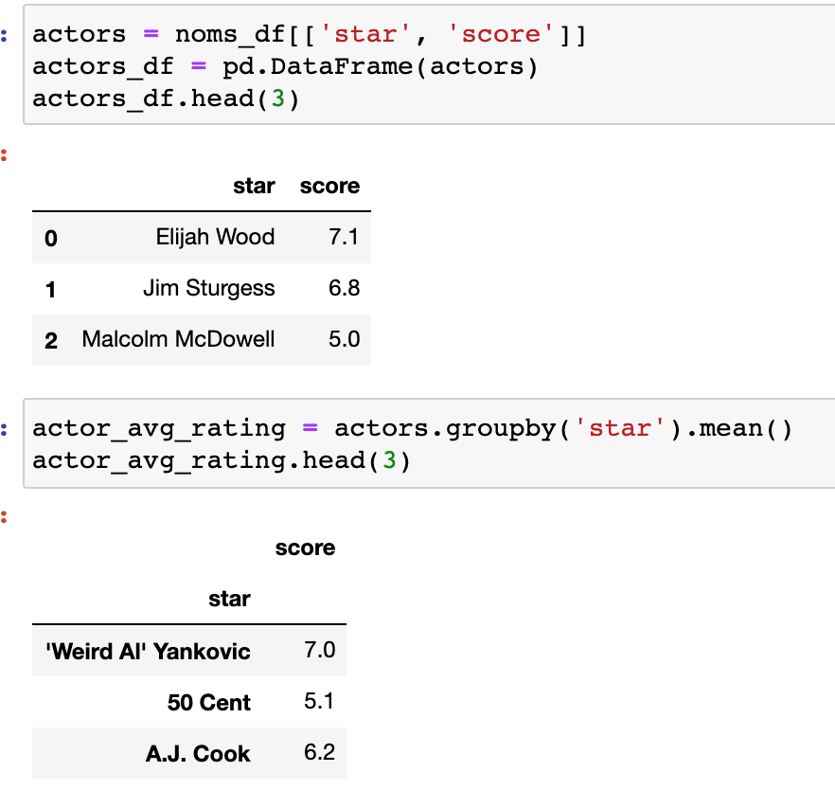
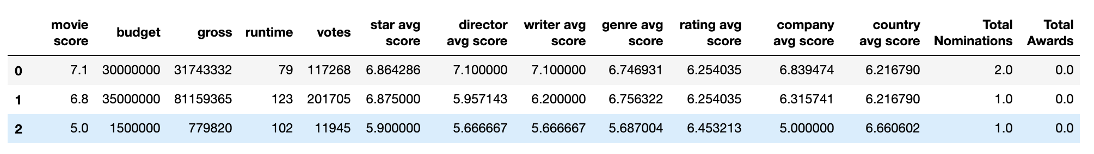
Merging Data

Slide 4
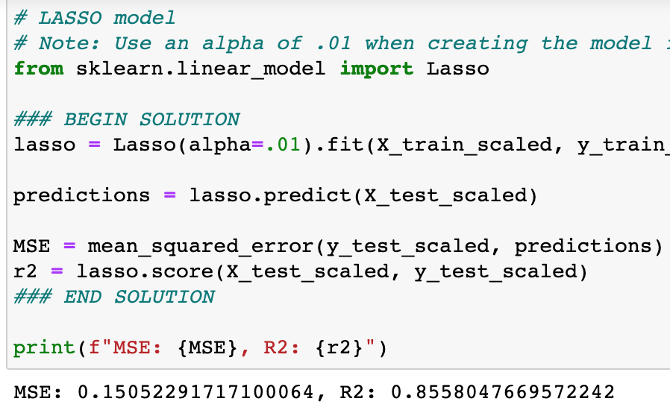
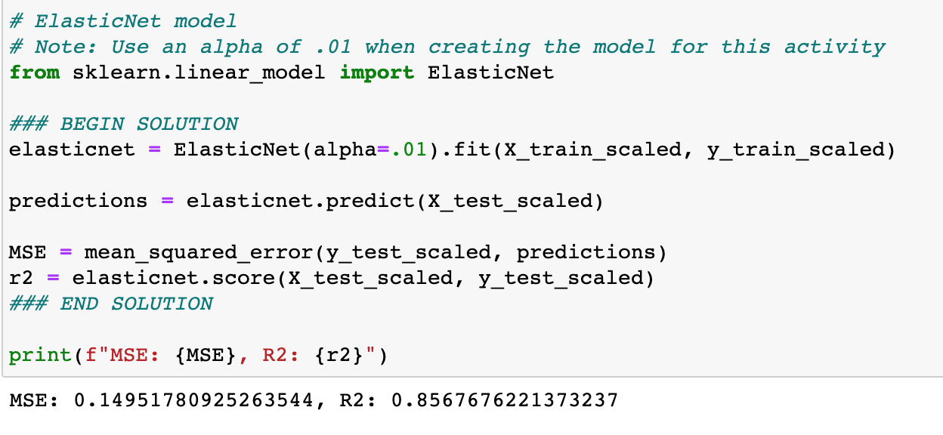
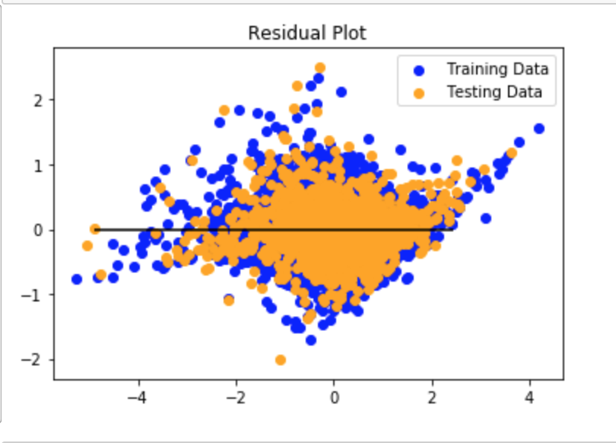
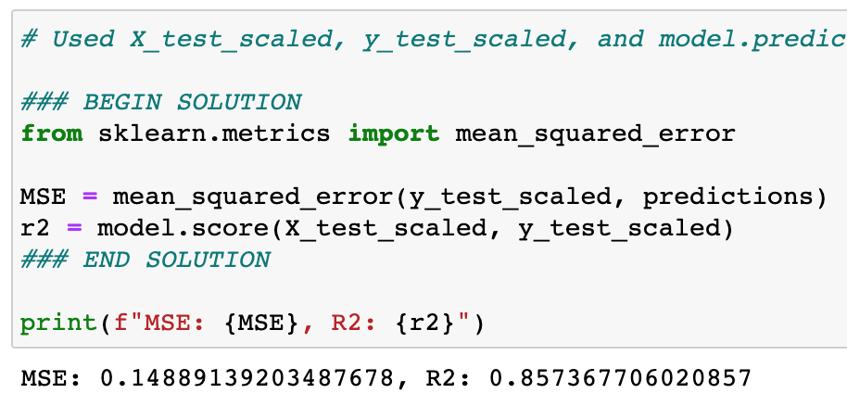
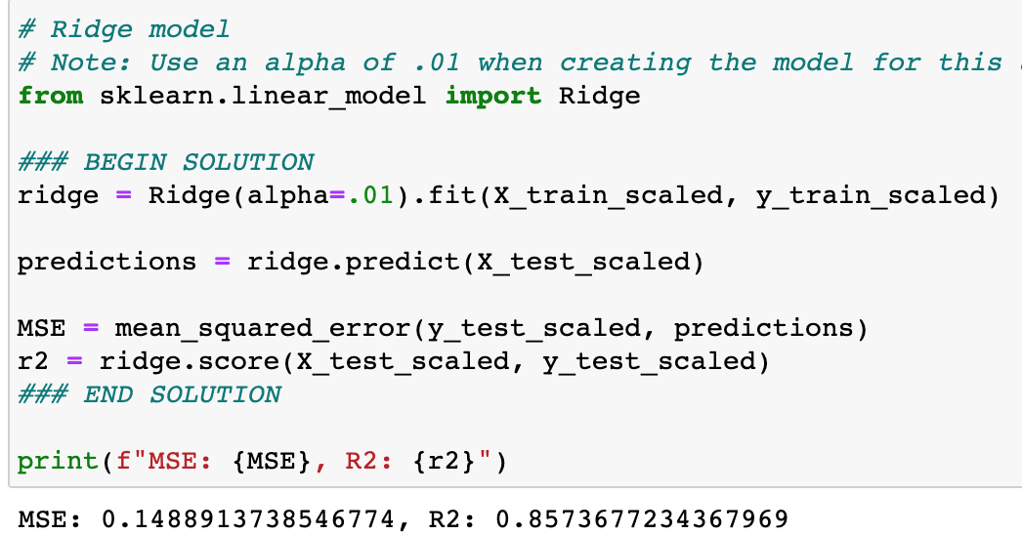
Linear Regression

Slide 5
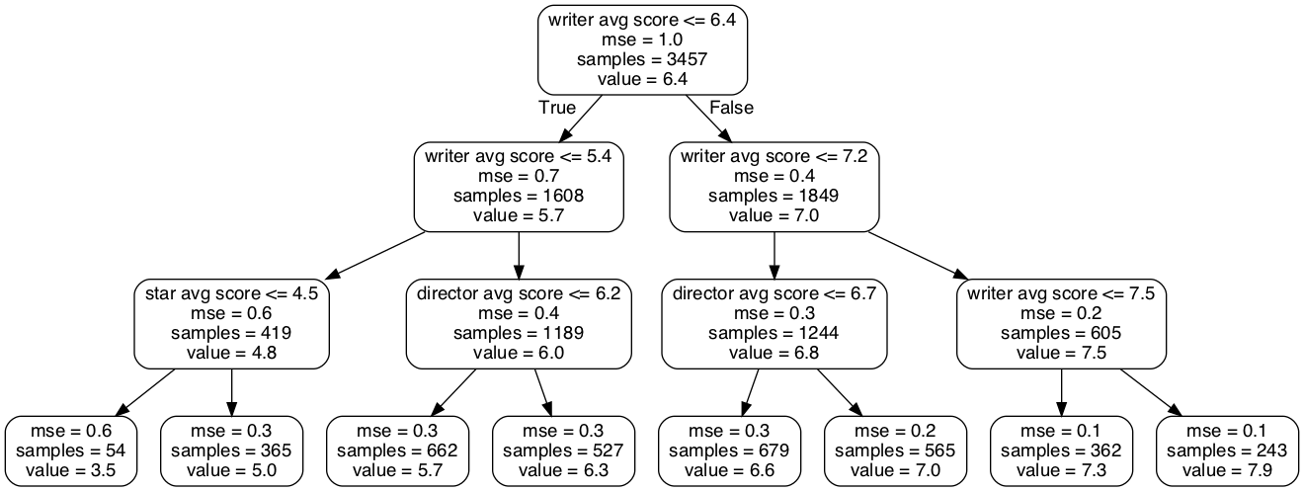
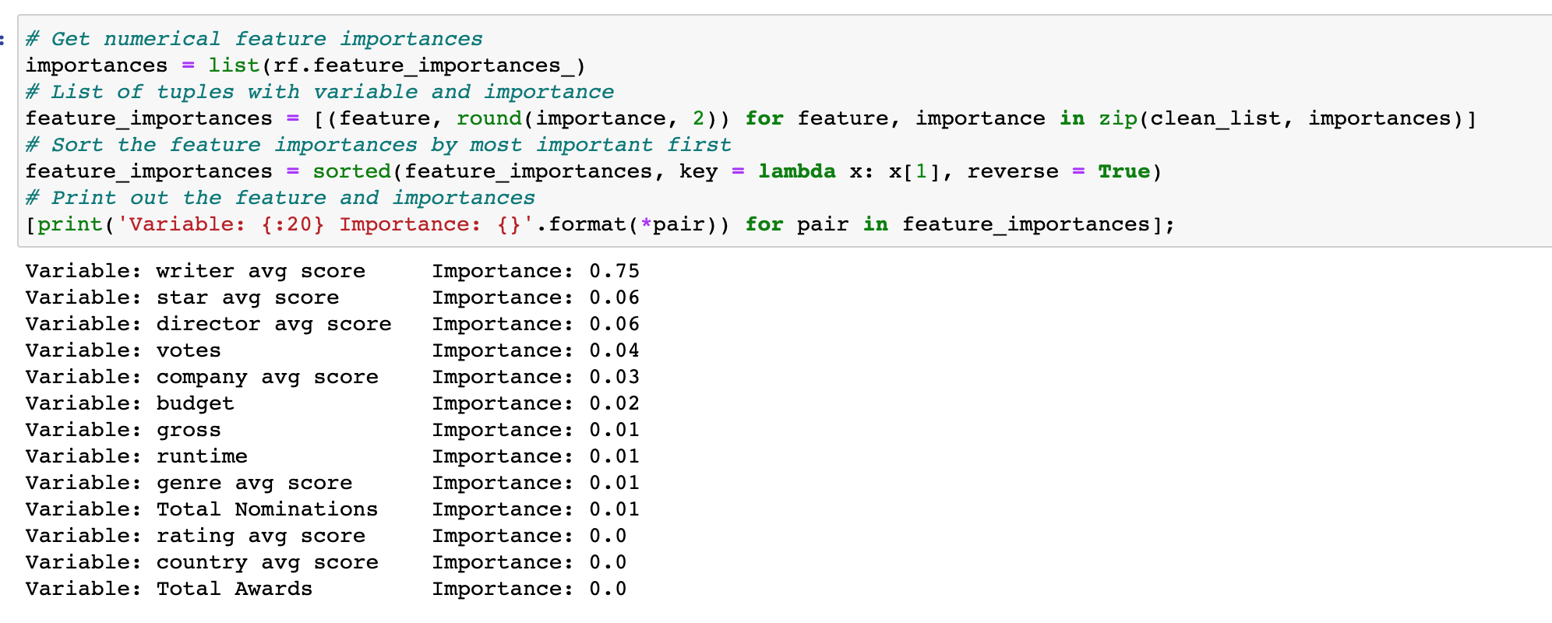
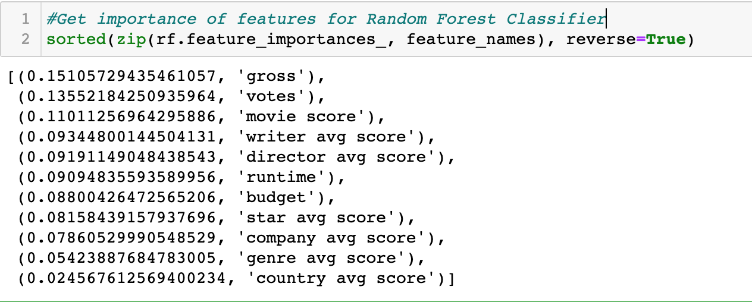
Random Forrest

Slide 6
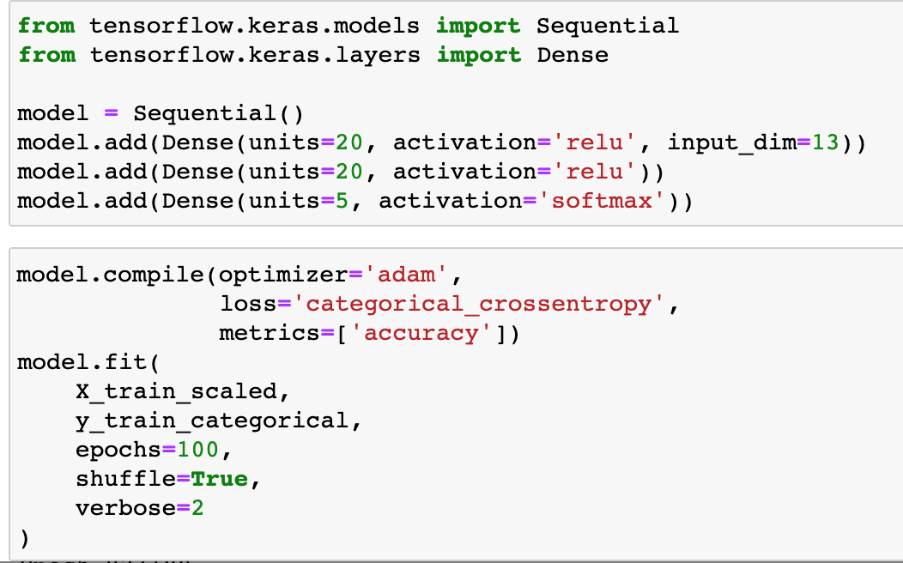
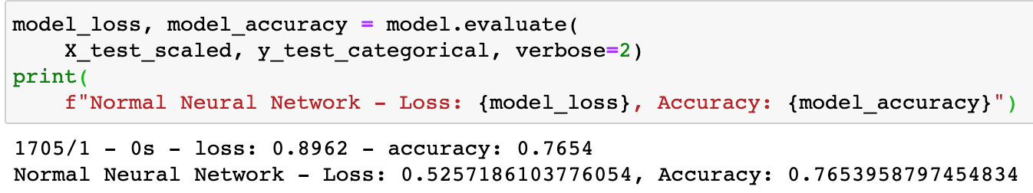
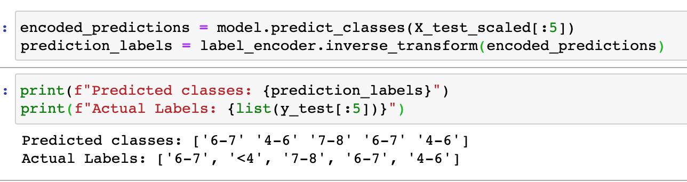
Deep Learning Model
5 Classes

Slide 7
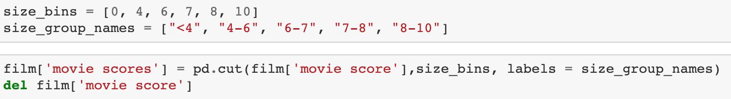
Deep Learning – IMDb Predictions

Slide 8
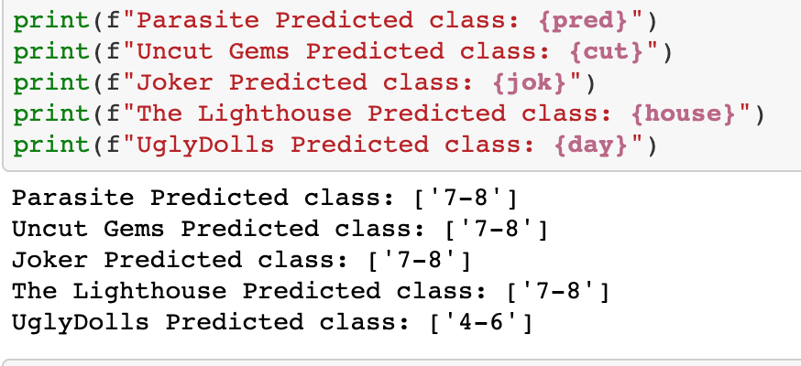
IMDb Testing model
Parasite actual score – 8.6
Uncut Gems score – 7.5
Joker score – 8.5
Lighthouse score – 7.6
UglyDolls – 4.9

Slide 9
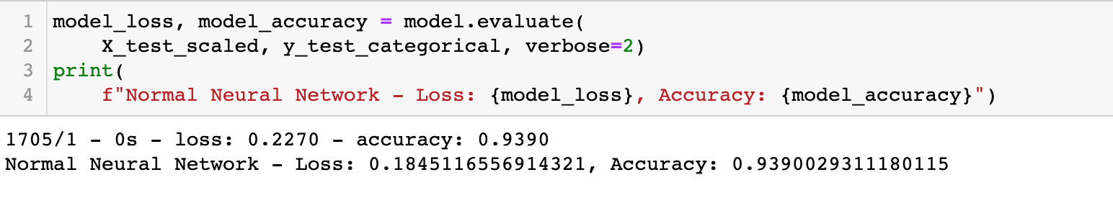
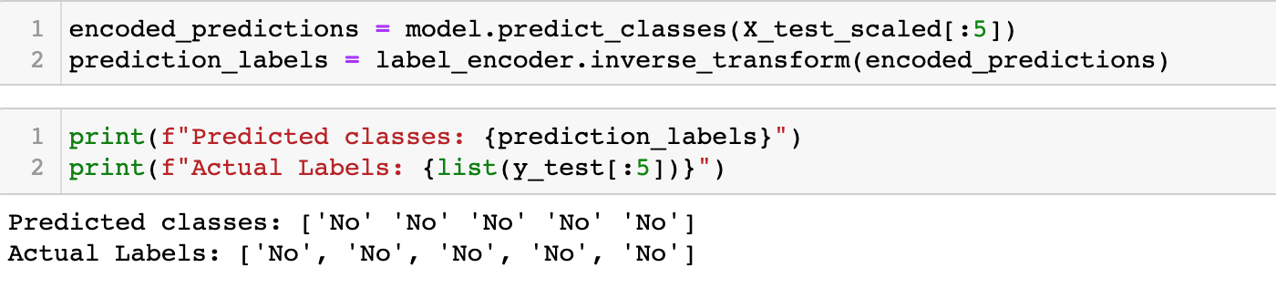
Deep Learning – Award Predictions

Slide 10
Tableu
https://public.tableau.com/profile/robert.mclauchlan - !/vizhome/MovieUpdated/FilmCompanyRevBudget

Slide 11
Conclusion

